Slide 1
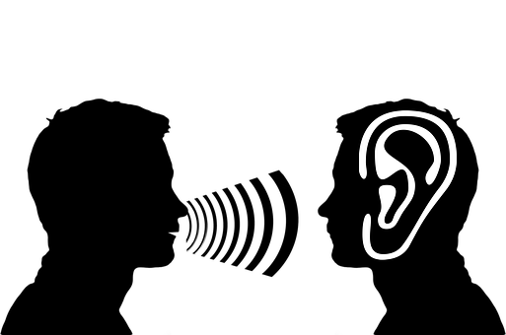
Decoding language
Teaching - not testing - listening skills

Slide 2
Listening:
An undervalued skill
Listening skills have been undervalued: why?
Historically, listening materials were used only as a means to teach language
Listening skills are difficult to teach:
  They were seen as passive skills
  The material can’t be easily manipulated (unlike a reading text)
It was assumed that they will be learnt automatically

Slide 3
Imagine this scenario:
During a reading lesson
Teacher: Now read paragraph 1. How does the character feel? Discuss with your partner. Student 1: The character feels angry. Teacher: I think so too! What words helped you understand that? Underline them and show them to your partner. Student 2: We’ve found ‘annoyed’ and ‘offended’. Student 1: I’ve found this word ‘rage’ - what does it mean? Teacher: Look at the words around ‘rage’. Can you find anything to help you? Student 1: Well, it says ‘red in the face’ and ‘feel rage’. Teacher: Ok. So if we put together all that we have found...

Slide 4
Listening:
An essential skill
Today, listening skills are considered essential for second language acquisition and they need to be taught: why?
Listening skills are useful in everyday life
To master speaking skills, listening must be developed
Weak listening leads to insecurity

Slide 5
Current format for a listening lesson
Pre-listening
  Establish context
  Create motivation for listening
  Pre-teach only critical vocabulary
Extensive listening
  General questions on context and attitude of speakers
Intensive listening
  Pre-set questions
  Listening for specific information
  Checking answers to questions
Post-listening (optional)
  Functional language in listening passage
  Inferring meaning of unknown words from context
  Task/Problem solving activity

Slide 6




Common issues for L2 students
a. English people speak so fast!
b. I’ve heard this word before, but I couldn’t recognise it in the text…
f. Who are these ‘Beatles’ the teacher keeps talking about?
d. My host mother was talking about the weather a minute ago…she’s now talking about something else…I can’t follow the conversation!
e. What does ‘firstable’ mean???
(first of all)
c. This new teacher is harder to understand…
What are the language problems behind the comments in the speech bubbles?

Slide 7
Re-think methodology aka
"Guiding students to succeed in better understanding spoken language"
Language factors
Other factors
Pronunciation
  Individual sounds
  Connected speech
  Accents
  Strong/weak sounds
Vocabulary
  Collocations
  Synonyms
  Spelling
Context
  Prior knowledge of topic
  Purpose of listening (motivation)
  Pragmatics
External factors
  Background noise
  Speaker’s voice

Slide 8
Listening strategies
Content words (noun, verbs, adjectives)
Signposts (Phrases like ‘I’d like to tell you about…’, ‘Let’s move on to…’, ‘In conclusion…’)
Inferring meaning (words understood + prior knowledge of the situation)
Active listening (concentrating on what is being said and showing participation and understanding.)
- non-verbal communication
- showing interest
- asking for clarification
- confirming understanding

Slide 9

Have we been teaching or testing listening skills?

